Slide 2
Thesis Presentation
Prince Frederick Hall, University of Maryland
Completed by: Lauren Kandt
PSU AE, Construction Management
Advisor: Ray Sowers
2 April 2014

Slide 3
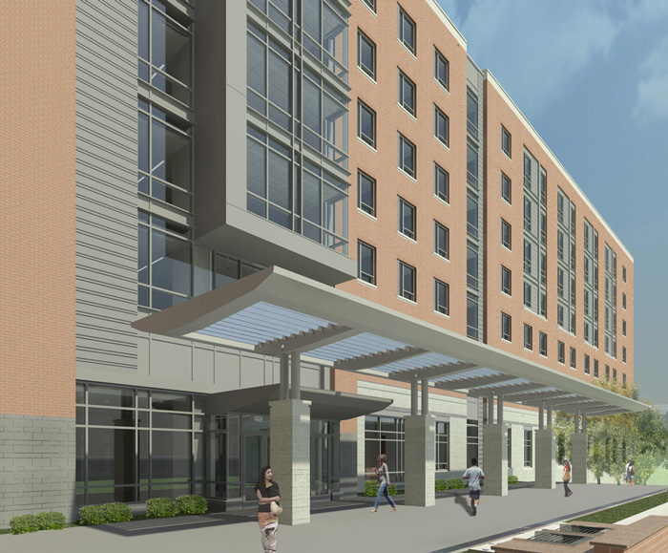
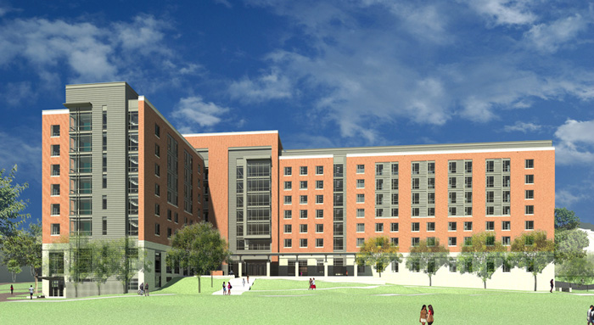
Introduction
Building Information
Infinity System Investigation
Grey Water System Investigation
Photovoltaic Cell Window Investigation
Architectural Breadth
Information Transfer Research
Survey Results
App Business Plan
Recommendation

Slide 4
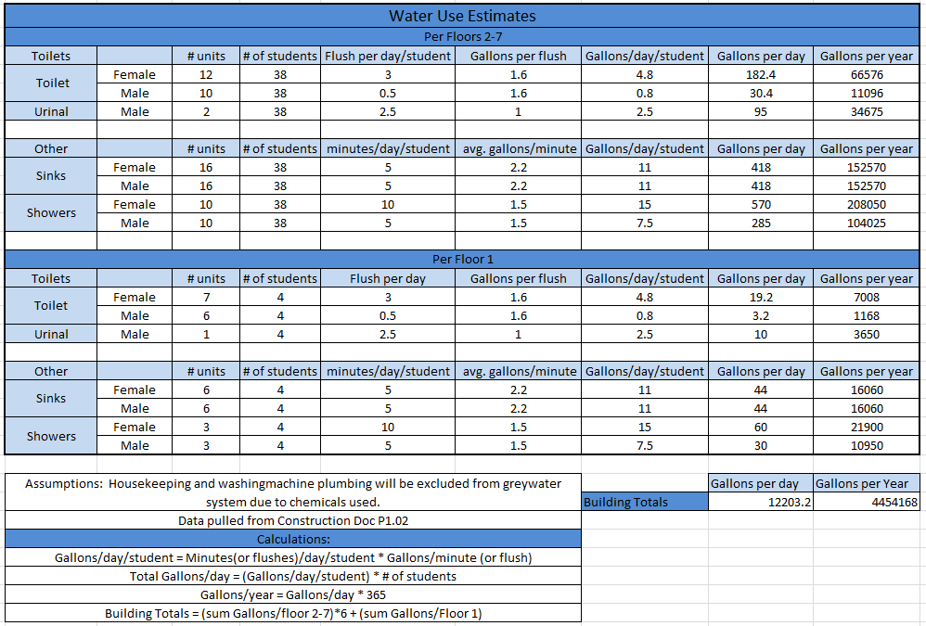
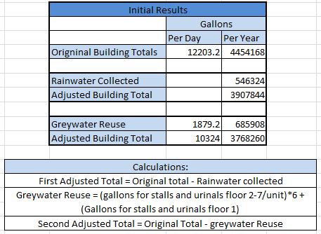
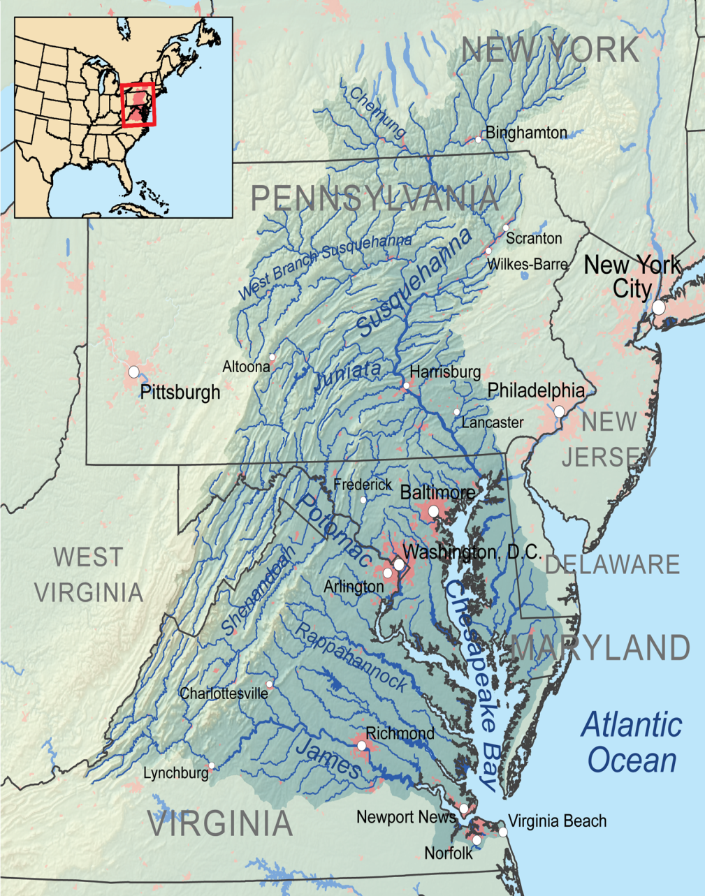
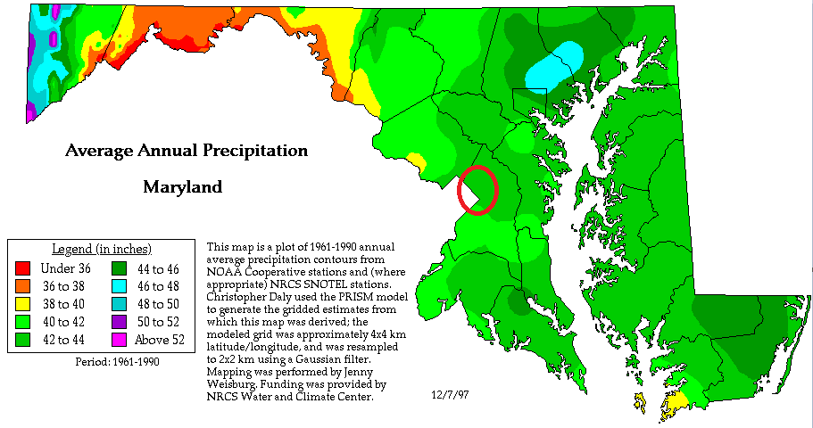
Grey Water System Investigation
Introduction
Building Information
Infinity System Investigation
Grey Water System Investigation
Photovoltaic Cell Window Investigation
Architectural Breadth
Information Transfer Research
Survey Results
App Business Plan
Recommendation

Slide 5
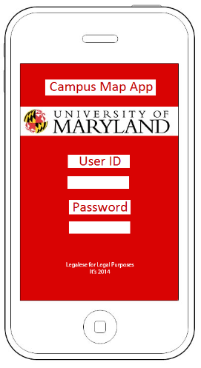
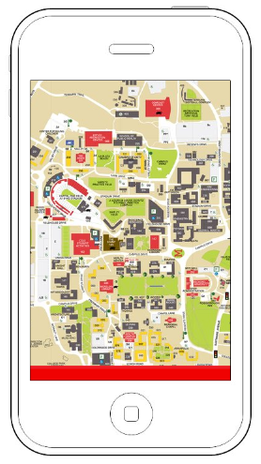
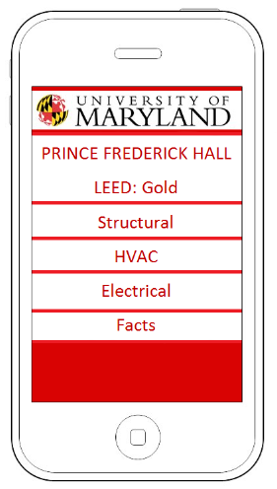
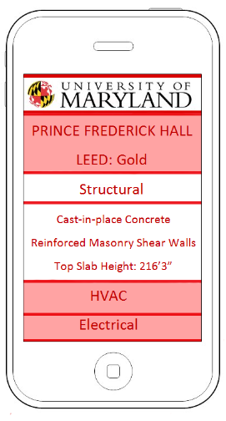
Information Transfer Research
Introduction
Building Information
Infinity System Investigation
Grey Water System Investigation
Photovoltaic Cell Window Investigation
Architectural Breadth
Information Transfer Research
Survey Results
App Business Plan
Recommendation

